Slide 1
Multimodal Generative AI: The Future of Human-AI Creativity
Name: ABHINAND.S
Roll No: 02
Reg No: MES22AD002
Guide: MR. SHERIKH KK
Department: ADS, MESCE
Date:07-08-2025

Slide 2
Agenda
Introduction
Problem Statement
Objectives
Literature Review
Methodology
Tools & Technologies
Applications
Pros & Cons
Future Scope
Conclusion
References

Slide 3
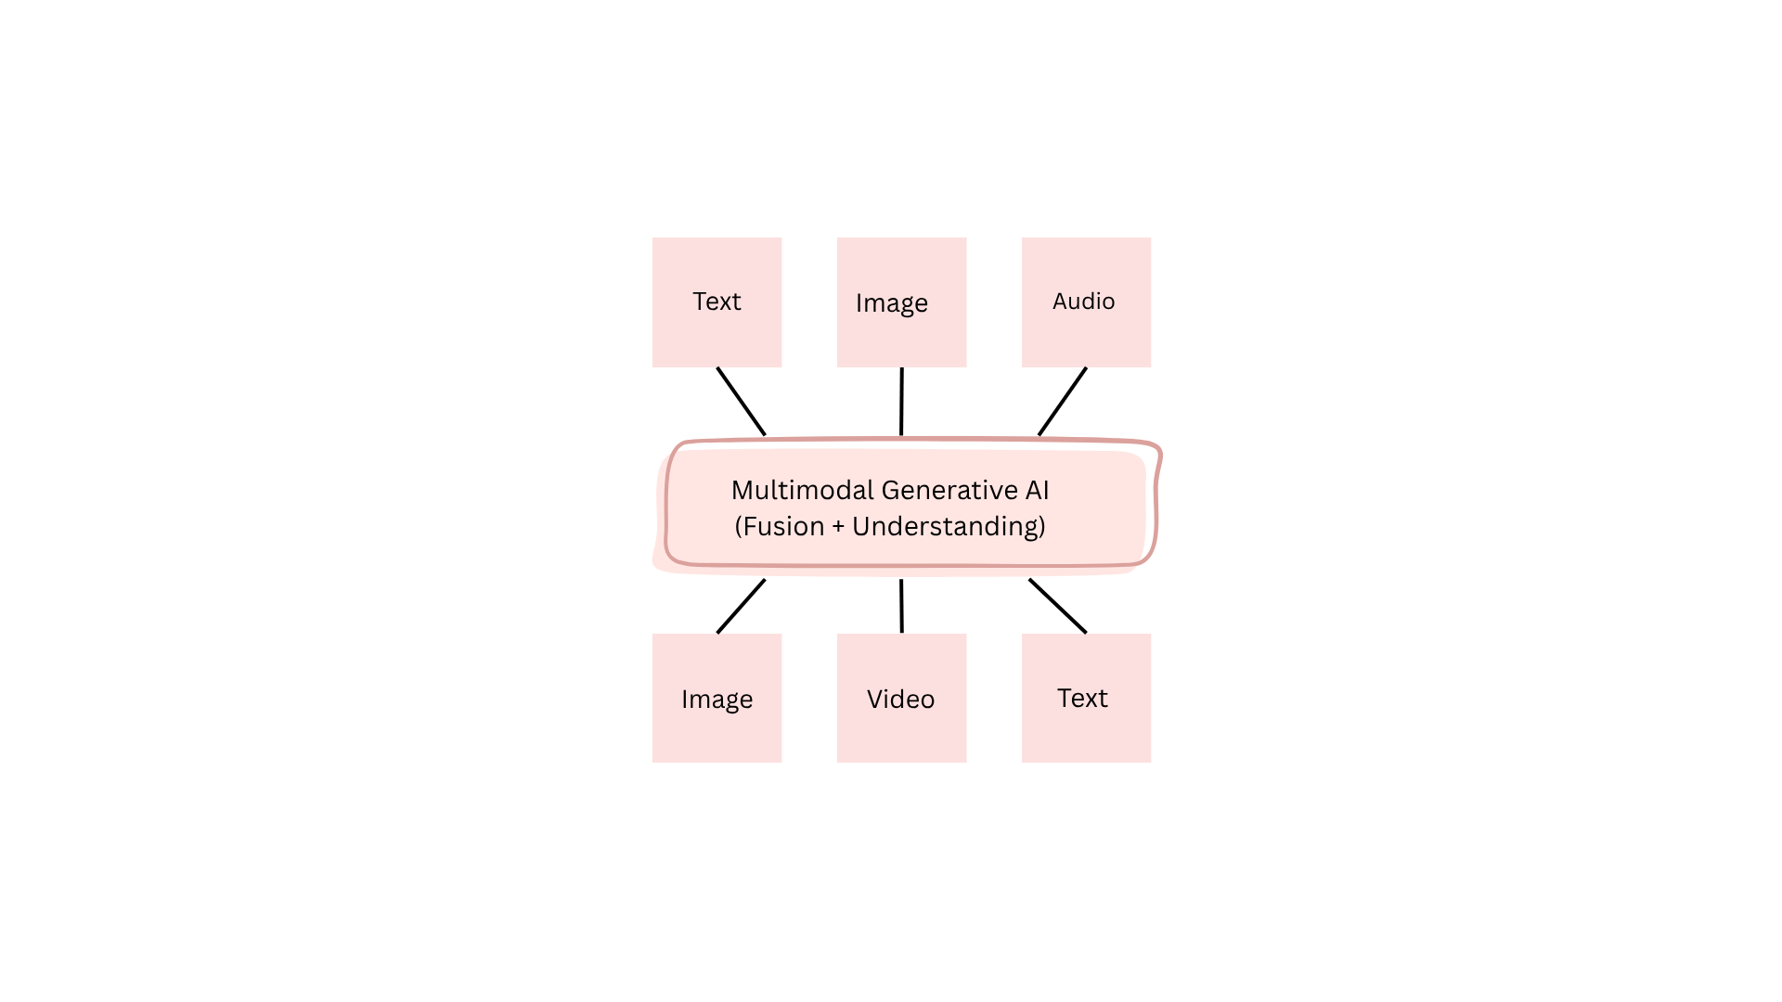
Introduction
Combines data from text, image, audio, and video
Enables cross-modal understanding
Use cases: storytelling, sketch-to-image
Facilitates creative human-AI collaboration
Enhances multimodal content creation
Examples: GPT-4o, Sora
Industry-driven adoption
Img 1 – Multimodal AI: Combines text, image, and audio to generate diverse outputs.

Slide 4
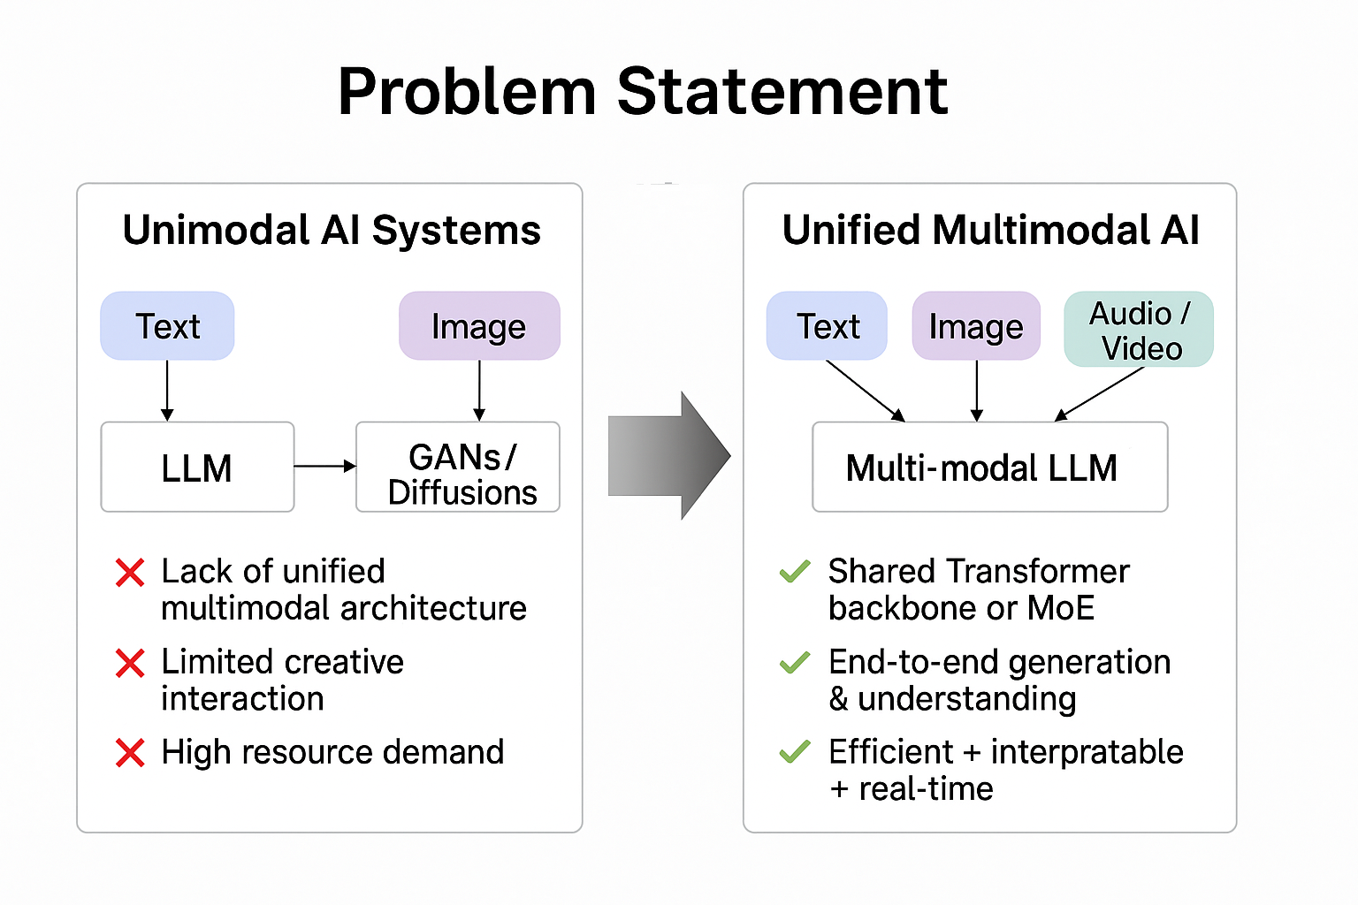
Problem Statement
Existing AI systems are unimodal
Lack of unified multimodal architecture
Limited creative interaction
High resource demand
Issues with real-time processing
Poor interpretability in generation
Constrains innovation
Fig 2 – Unified Models: Transitions from separate to unified multimodal AI systems.

Slide 5
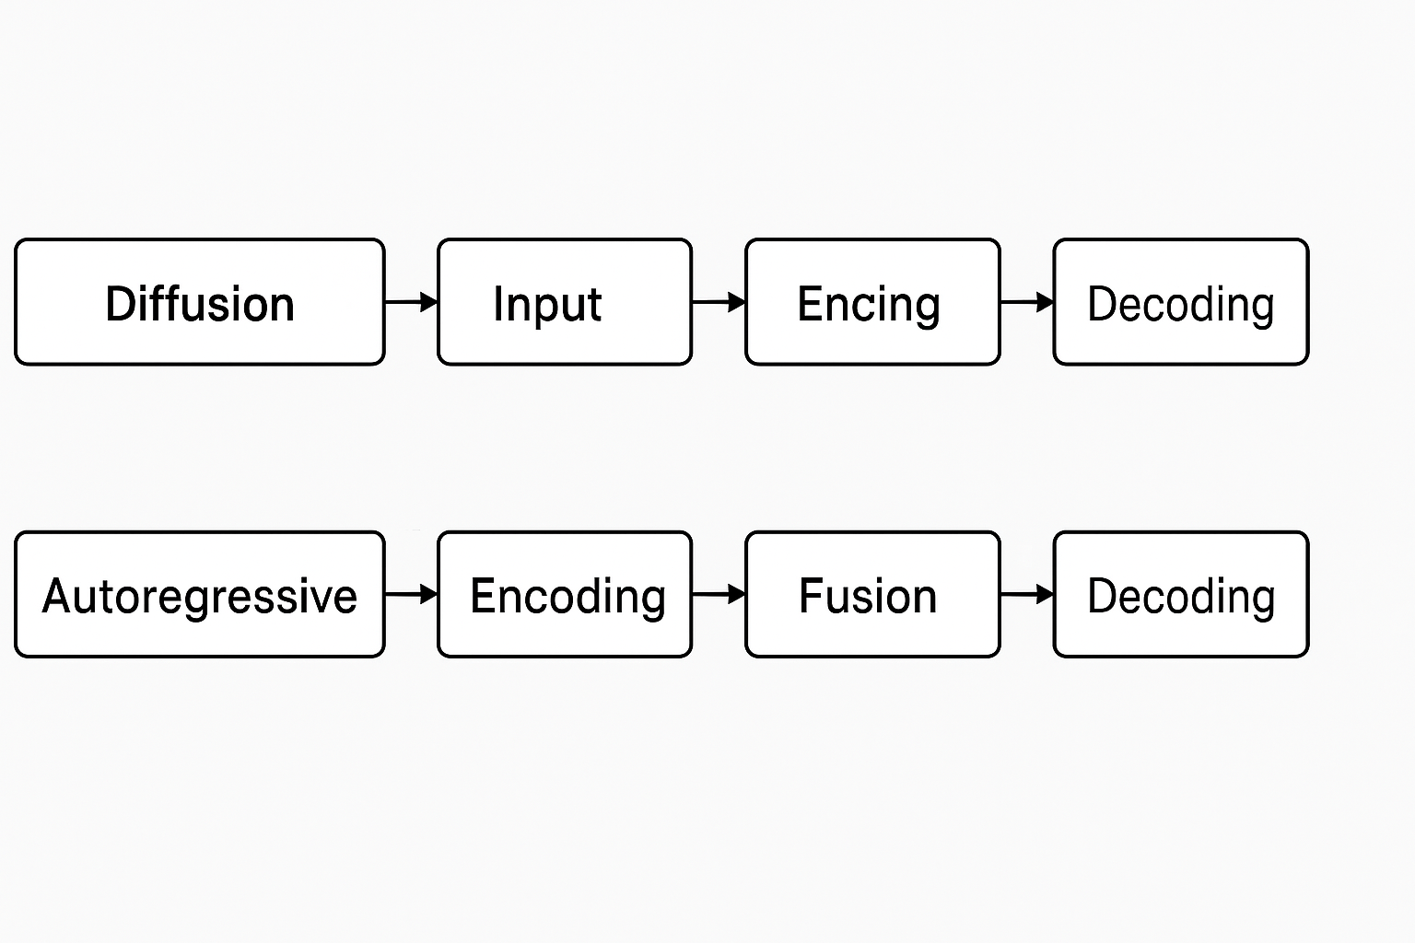
Objectives
Explore working of multimodal AI models
Analyze creative and design applications
Identify gaps in current approaches
Evaluate methods like diffusion and transformers
Study tools enabling multimodal generation
Fig 3 – Pipelines: Compares diffusion and autoregressive generation workflows.

Slide 6
Literature Review
Title | Authors, Year | Method | Result
Multi-modal Generative AI: Multi-modal LLMs, Diffusions and the Unification[1] | Xin Wang et al., 2025 (IEEE) | Unified transformer + diffusion | Framework for multimodal prompt-based generation
Multimodal Image Synthesis and Editing: The Generative AI Era[2] | Zhan et al., 2024 (IEEE TPAMI) | Diffusion & GANs | High-quality image synthesis; fast GAN inference
Sketch-to-Image via Diffusion Model for Superior Visual Synthesis[3] | Roy et al., 2023 (UTS, IIT KGP) | Sketch-guided diffusion | Photorealistic images from sketches
DiffSketching: Sketch-Controlled Diffusion Models[4] | Wang et al., 2023 | Sketch-controlled diffusion | Precise sketch-to-image synthesis
Multimodal Explainable Artificial Intelligence: A Comprehensive Review[5] | Nikolaos Rodis et al., 2024 (IEEE Access) | Multimodal XAI (Grad-CAM, SHAP, DME) | Interpretable explanations for VQA, captioning
Summary of recent research on multimodal generative AI methods and results

Slide 7
Working Principle
Based on Xin Wang et al. (2025) – unified multimodal LLM + diffusion framework
Handles diverse inputs: text, sketch, and audio
Uses modality-specific encoders for flexible input processing
Aligns modalities using attention-based fusion
Supports high-quality, prompt-based generation
Ideal for creative and stylized multimodal outputs

Slide 8
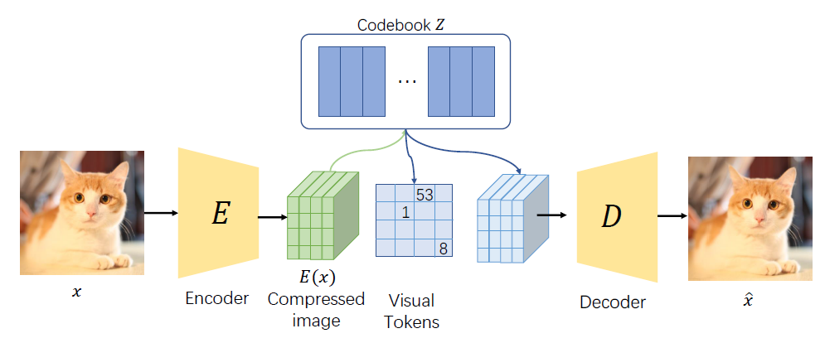
Working Principle (Input & Encoding)
Input: Text, sketch, or audio prompts
Modality-specific encoders: transformer, CNN, spectrogram
Text: Tokenized and encoded by LLM
Image: Processed via convolutional encoder
Audio: Converted to spectrograms
Ensures semantic alignment
Prepares for fusion
Fig 4 – Visual Tokenization: Encodes and decodes images through discrete visual tokens.

Slide 9
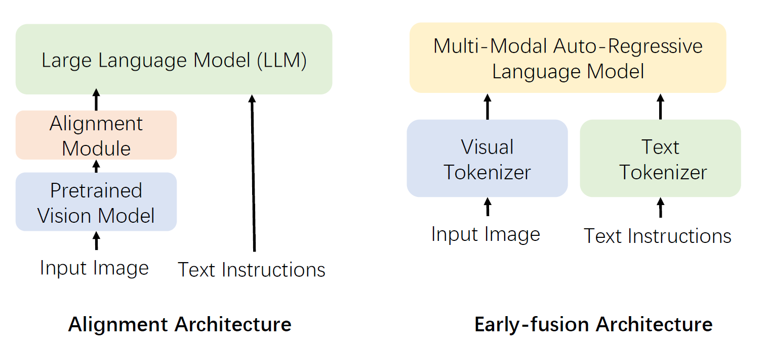
Working Principle (Fusion)
Fusion via cross-attention/token fusion
Aligns latent representations
Combines embeddings across modalities
Transformer layers capture dependencies
Enhances contextual understanding
Flexible fusion techniques
Core step in multimodal generation
Fig 5 – Model Architectures: Contrasts alignment vs. early-fusion multimodal models.

Slide 10
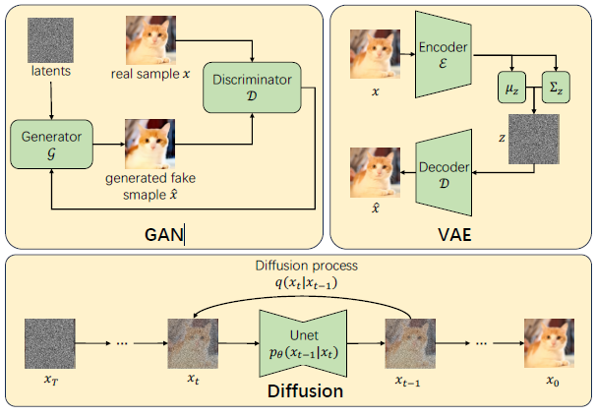
Working Principle (Decoding)
Decoding via diffusion or transformer decoder
LoRA, ControlNet for fine-tuning
Generates image/text/video output
Supports real-time generation
Ensures coherence across modalities
Domain adaptation for specific tasks
Achieves high fidelity outputs
Fig 6 – Generative Models: Shows how GANs, VAEs, and diffusion models work.

Slide 11
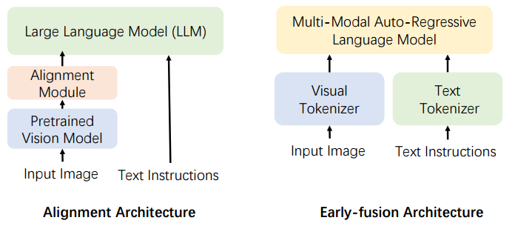
Tools & Technologies
GPT-4o: Unified vision + audio + text LLM
Gemini: Google’s multimodal model
CLIP: Vision-language alignment
LLaVA: Language-Vision Assistant
Combines perception and reasoning
Transformer-based alignment
Real-world deployment ready
Fig 7 – Comparison of Alignment and Early-fusion multimodal AI architectures for processing images and text.

Slide 12
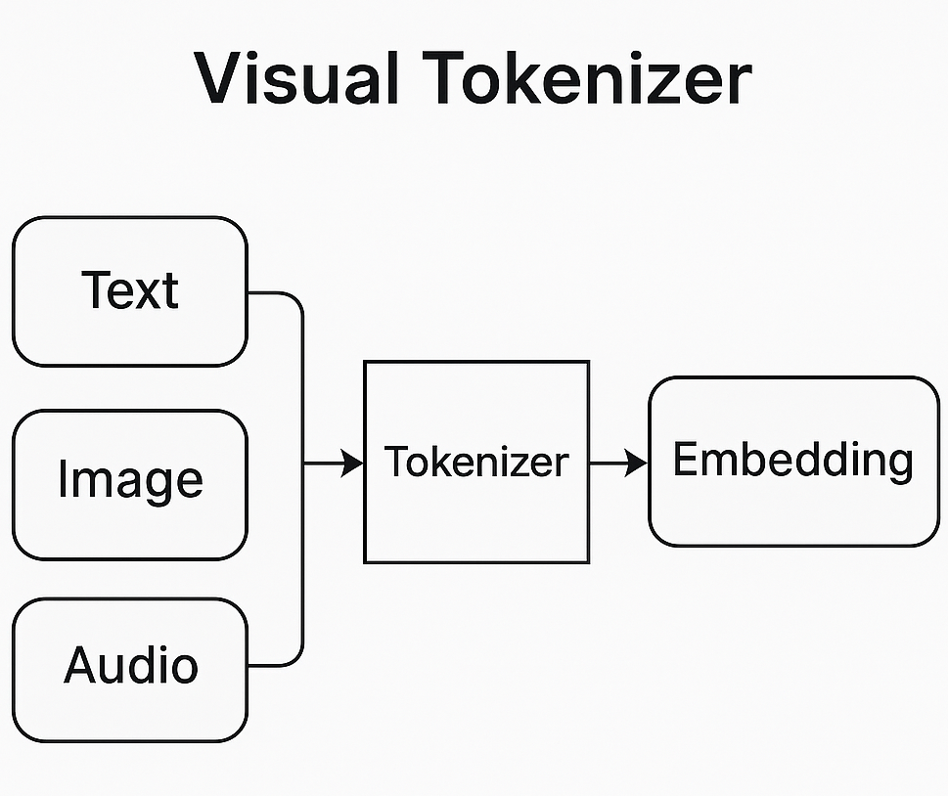
Tools & Technologies
Stable Diffusion: Text-to-image generation
ControlNet: Conditioning on inputs
Sora: Text-to-video by OpenAI
LoRA: Lightweight fine-tuning
LCMs: Low-latency diffusion models
Enables fast generation
Supports real-time applications
Fig 8 – Visual Tokenizer: Converts text, image, and audio into tokens for multimodal transformers.

Slide 13
Tools & Technologies
Datasets Used in Multimodal AI
Dataset Type | Modalities | Examples
Captions | Text-Image / Video | MSCOCO, CC-3M, LAION, WebVid
Conversation | Text-Image / Video | VQAv2, TextVQA, WebVidQA, EgoQA
Reasoning | Text-Image / Video | CLEVR, NExT-QA, CLEVRER
Integration | Multimodal | LLaVA-Instruct, Video-LLaVA, VideoChat2
Common multimodal datasets used for training and evaluating generative and understanding models

Slide 14
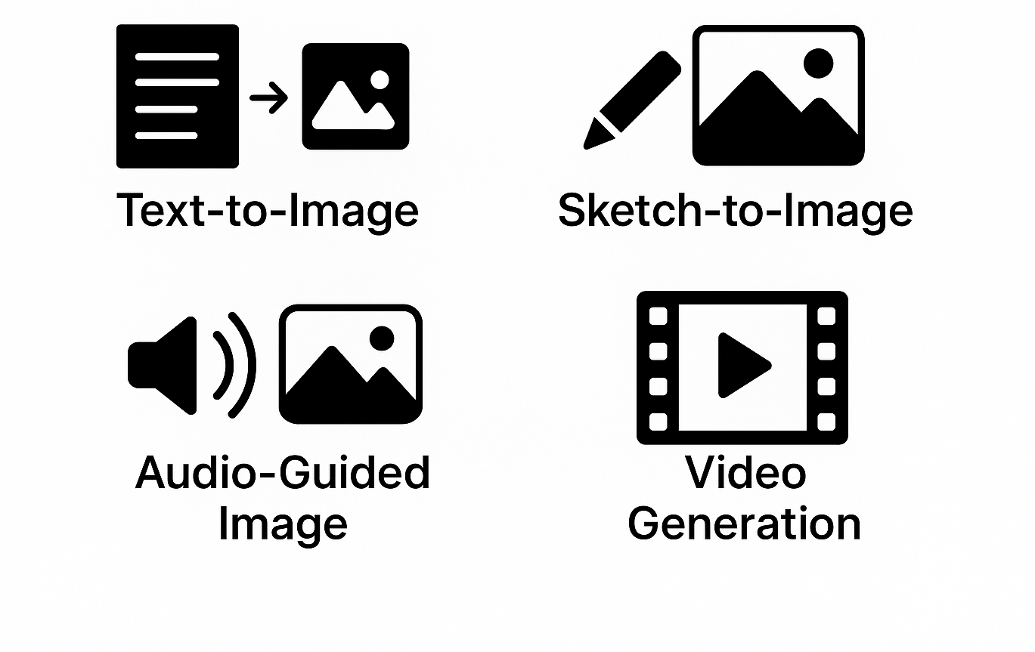
Applications
AI storytelling with visuals + narration
Educational tools with interactive visuals
Sketch-to-image design assistants
Generative art and concept visuals
Media content automation
Marketing and branding material
Virtual assistants with multimodal input
Fig 7 – Generation Modes: Examples: text-to-image, sketch-to-image, and more.

Slide 15
Applications
Gaming:character generation, environments
Smart assistants: voice and visual inputs
Prototyping in fashion and interior design
Creative coding environments
Virtual worlds: Metaverse integration
Accessibility: converting modalities
Custom avatars and 3D objects

Slide 16
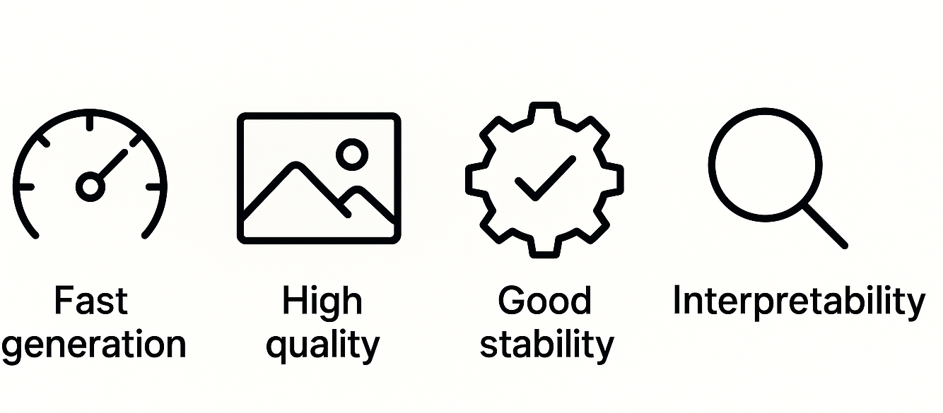
Advantages
Cross-modal creativity
Real-time generation support
Productivity boost
User-guided content generation
Aligns with creative goals
High flexibility in output
Emerging industry standard
Fig 8 – Model Traits: Lists key qualities: speed, quality, stability, interpretability.

Slide 17
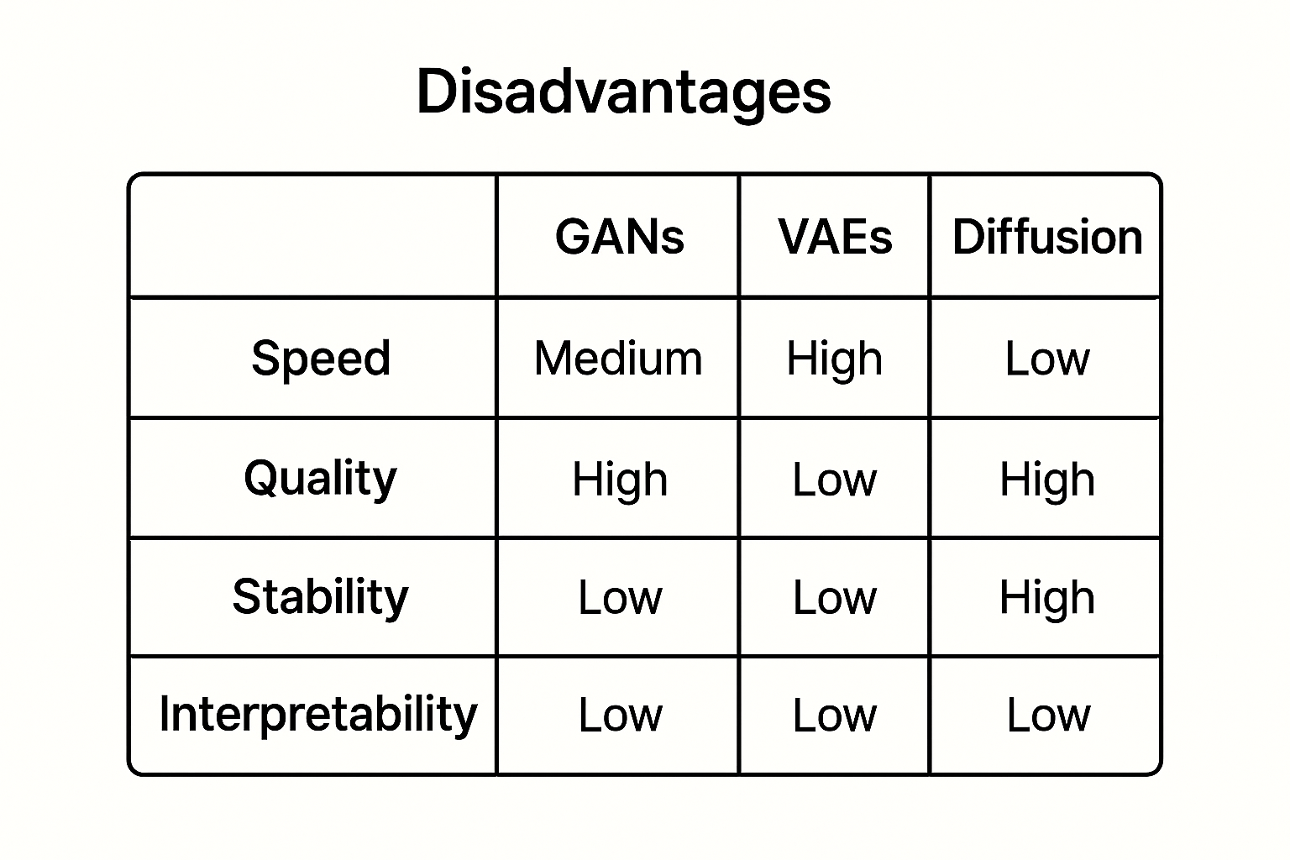
Disadvantages
High computational cost
Bias and hallucination risks
Lack of transparency
Difficult to interpret outputs
Requires large training datasets
Data privacy concerns
Complexity in architecture
Fig 9 – Model Comparison: Table comparing GANs, VAEs, and diffusion models.

Slide 18
Future Scope
Real-time multimodal AI agents
On-device deployment with LCMs
Edge computing support
Explainable Multimodal AI (XMAI)
Deeper AR/VR integration
Voice-image-sensor fusion
Human-AI creativity interfaces

Slide 19
Conclusion
Multimodal AI drives future creativity
Tools like GPT-4o, Sora show unified AI
Enables seamless prompt-to-output flows
Potential in all creative domains
Research remains fast evolving
Calls for responsible innovation

Slide 20
References
X. Wang, Y. Zhou, B. Huang, H. Chen, and W. Zhu, “Multi-modal generative AI: Multi-modal LLMs, diffusions and the unification,” IEEE Trans. Pattern Anal. Mach. Intell., early access, 2025.
F. Zhan, Y. Yu, R. Wu, J. Zhang, S. Lu, L. Liu, A. Kortylewski, C. Theobalt, and E. Xing, “Multimodal image synthesis and editing: The generative AI era,” IEEE Trans. Pattern Anal. Mach. Intell., early access, 2024.
S. Roy, A. Das, R. Ahuja, and A. Banerjee, “Sketch-to-image synthesis via diffusion models,” in Proc. IEEE/CVF Int. Conf. Comput. Vis. Workshops (ICCVW), Paris, France, Oct. 2023, pp.
L. Wang, Y. Liu, Z. Zhao, and X. Wu, “DiffSketching: Sketch-controlled image generation,” arXiv preprint, arXiv:2304.00877, Apr. 2023.
N. Rodis et al., “Multimodal explainable artificial intelligence: A comprehensive review of methodological advances and future research directions,” IEEE Access, vol. 12, pp. 830792–830845, Nov. 2024. doi: 10.1109/ACCESS.2024.3467062

Slide 21
References
X. Zhang et al., “Unified multimodal understanding and generation models: Advances, challenges, and opportunities,” Journal of LaTeX Class Files, vol. 14, no. 8, Oct. 2024.
Y. Dang et al., “Towards explainable and interpretable multimodal large language models: A comprehensive survey,” arXiv preprint, 2024.
T. Baltrušaitis, C. Ahuja, and L.-P. Morency, “Multimodal machine learning: A survey and taxonomy,” IEEE Trans. Pattern Anal. Mach. Intell., vol. 41, no. 2, pp. 423–443, Feb. 2019. doi: 10.1109/TPAMI.2018.2798607

Slide 22
Thank You
Questions & Discussion Welcome Feel free to ask anything related to the topic.
Presented by:
ABHINAND S
MES22AD002
Dept. of Artificial Intelligence & Data- Science
MES College of Engineering,Kuttippuram

